Slide 1
DSA BOOTCAMP
CONDUCTED BY GDSC ICOER
PRESENTED BY SATYAM SINGH RAJPUT

Slide 2
ARRAYS

Slide 3


Slide 4

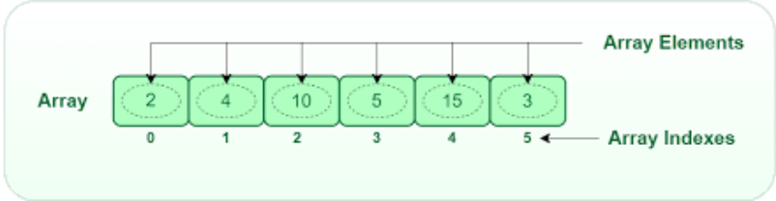
Introduction to Arrays
Arrays is a list of elements of same data type placed in a Contiguous Memory Location .
Q ) Why Arrays are always Stored in Straight Line ?

Slide 5

Declaration of Arrays
1
In JAVA :
2
In C++ :
3
In Python:
Datatype [ ] arrayname = new Datatype [Size];
Datatype arrayname [ Size] ;
my_array = [ value 1 , value 2 , value 3 , ..]

Slide 6
Characteristics of Arrays
Datatype [ ] arrayName = new Datatype [ Size ] ;
1 ) Datatype = include datatypes like int , char , float etc.
2 ) arrayName = The name given to an Array by an user during the creation of an Array
3 ) new = The 'New ' is a keyword used to create a location in the memory.
4 ) [ Size ] = The ' Size ' of an Arrays means the number of Arrays the user want to create .

Slide 7

Operations in Arrays
1
Insertion
We can insert elements into an array at any position, shifting existing elements if necessary.
Deletion
2
Elements can be removed from an array, and the remaining elements will be shifted to fill the gap.
3
Search
We can search for an element in an array using various algorithms such as linear search or binary search.
Update
4
We can update the existing Array by adding an element in an Array or deleting an element from an Array .

Slide 8
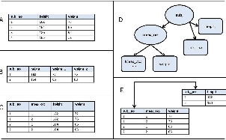
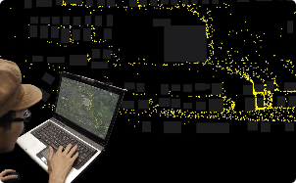
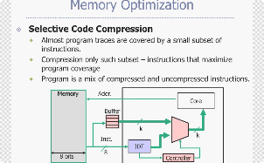
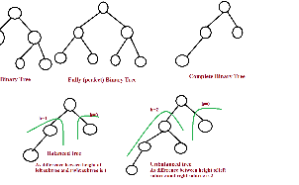
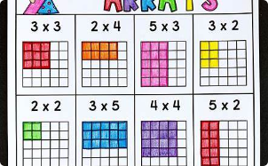

Importance of Arrays
Data Organization
Data Manipulation
Memory Optimization
Arrays provide an efficient way to organize and store large amounts of data in a structured manner.
With arrays, we can easily perform operations like sorting, filtering, and transforming data.
Arrays allow for efficient memory allocation and utilization, reducing the overall memory footprint.
Data Structure
Two Dimensional Arrays
Sequential Data Processing
For the more Complex data structures like Stack , Queue etc.
Arrays can be multi Dimensional enabling you to represent complex data structures .
You can easily loop through an array , performing operation on each one by one .

Slide 9
Creating an Array
Q ) Create an Arrays to Store a marks of 5 Subjects ?
C ++
#include <iostream>
int main() { // Declare an array to store marks for 5 subjects int marks[5];
for (int i = 0; i < 5; i++) {
std::cout << "Enter marks for subject " << (i + 1) << ": ";
std::cin >> marks[i];
}
std::cout << "Marks for 5 subjects: " << std::endl;
for (int i = 0; i < 5; i++) {
std::cout << "Subject " << (i + 1) << ": " << marks[i] << std::endl;
}
return 0;
}

Slide 10
Creating an Array
Q ) Create an Arrays to Store a marks of 5 Subjects ?
Python :
marks = []
for i in range(5):
subject = input("Enter marks for subject {}: ".format(i + 1))
marks.append(float(subject))
print("Marks for 5 subjects:")
for i in range(5):
print("Subject {}: {:.2f}".format(i + 1, marks[i]))

Slide 11
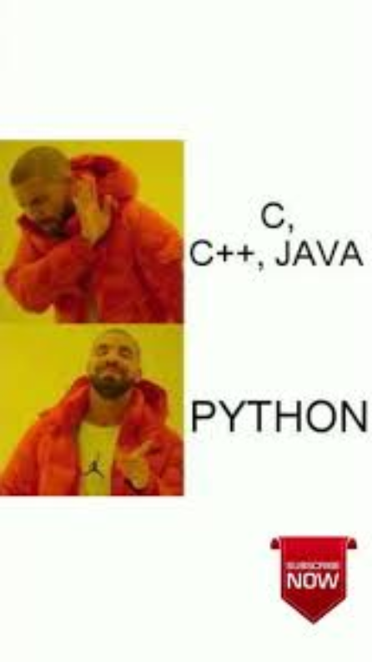

Slide 12

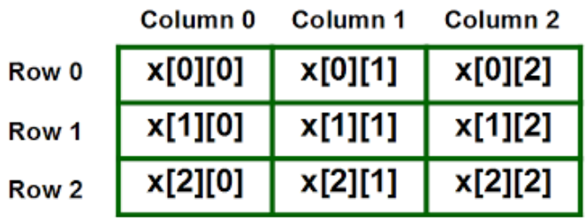
Two Dimensional Arrays

Slide 13


Introduction to Two Dimensional Arrays
. Two-dimensional arrays extend the concept of arrays by adding a second dimension. Each element now has two indices, allowing us to access data in rows and columns.
. Two - Dimensional Arrays is like a table with Rows and Columns .
. In Two - Dimensional Arrays elements are accessed using two indices - Rows and Columns.

Slide 14
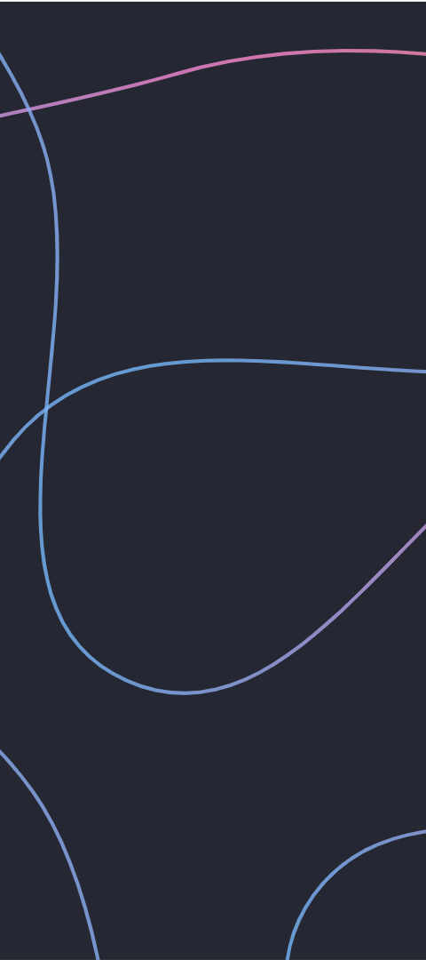
Declaration of Two Dimensional Arrays
In Java:
In Python:
Datatype [ ] [ ] arrayname = new datatype [ rows ][columns];
matrix = [ [ value 11 , value 12 , .. ] , [ value 21 , value 22 ]
EX : int [ ] [ ] matrix = new int [3] [4 ] ;
EX : matrix = [[0, 0, 0, 0], [0, 0, 0, 0], [0, 0, 0, 0]]
In C ++ :
Datatype arrayname [Rows] [ Columns ] ;
EX : int matrix [3] [4] ;

Slide 15
Creating a Two Dimensional Array
Q ) Write an code to create a Two Dimensional Array for 3 × 4 matrices ?
C ++
#include <iostream> int main() { int matrix[3][4]; std::cout << "Enter values for the 3x4 matrix:" << std::endl; for (int i = 0; i < 3; i++) { for (int j = 0; j < 4; j++) { std::cout << "Enter value for matrix[" << i << "][" << j << "]: "; std::cin >> matrix[i][j]; } } std::cout << "Matrix contents:" << std::endl; for (int i = 0; i < 3; i++) { for (int j = 0; j < 4; j++) { std::cout << matrix[i][j] << " "; } std::cout << std::endl; } return 0; }

Slide 16
Creating a Two Dimensional Array
Q ) Write an code to create a Two Dimensional Array for 3 × 4 matrices ?
Python
matrix = []
for i in range(3):
row = []
for j in range(4):
value = int(input(f"Enter the value for element at row {i+1}, column {j+1}: "))
row.append(value) # Add the value to the row
matrix.append(row) # Add the row to the matrix
for row in matrix:
print(row)

Slide 17
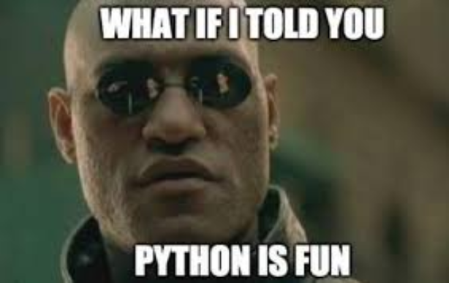


Slide 18

Sorting Algorithms in Arrays
1
Bubble Sort
A simple and inefficient sorting algorithm that repeatedly compares adjacent elements and swaps them if they are in the wrong order.
2
Selection Sort
A sorting algorithm that repeatedly selects the smallest element from the unsorted portion of the array and places it in its correct position.
3
Quick Sort
A fast and efficient sorting algorithm that uses a divide-and-conquer approach to recursively partition the array into smaller subarrays.
4
Merge Sort
Merge Sort is a popular sorting algorithm that follows the divide-and-conquer approach to sort an array or list of elements
5
Heap Sort
Heap Sort is a comparison-based sorting algorithm that uses a binary heap data structure to sort elements in an array. It has a time complexity of O(n log n) and is an in-place sorting algorithm.
6
Counting Sort
Counting Sort is a non-comparison-based sorting algorithm that works well for integers or elements within a known range. It counts the number of occurrences of each element and uses this information to place the elements in their sorted order.
7
Radix Sort
Radix Sort is a non-comparison-based sorting algorithm that works by distributing elements into buckets based on their individual digits or character positions. It processes the elements one digit at a time, starting from the least significant digit (rightmost) to the most significant digit (leftmost).
8
Bucket Sort
Bucket Sort is a non-comparison-based sorting algorithm that divides an array into a finite number of buckets, each of which is then sorted individually, either using a different sorting algorithm or recursively applying Bucket Sort.

Slide 19

Practical Applications of Arrays
Storing and Processing Data
Image Processing and Manipulation
Graphical User Interfaces (GUI)
Simulation and Modeling
DataBase Management

Slide 20

Conclusion
. Defination and types of Arrays
. Different operations in an Arrays
. Creation of an Arrays
. Examples of Arrays and Two Dimensional Arrays
. Applications of an Arrays

